Slide 1

Parallel Processing Of Enhanced K-Means Using Momentum and Repulsion
Bittu Jaiswal
Department of Computer Science
Mahindra Universirty
Supervisor
Dr. Praveen Kumar Alapathi
Department of Computer Science
Mahindra Universirty

Slide 2
K-Means Clustering
Definition: K-Means is a popular clustering algorithm that partitions a dataset into K clusters by grouping data points based on their similarity.
Key Idea: The algorithm aims to minimize the sum of distances (usually Euclidean) between each data point and the centroid (center) of its assigned cluster.
Challenges:
Computationally expensive for large datasets due to iterative recalculation of centroids and assignments.
Sensitive to initial centroid placement, which can affect convergence and final clusters.
May converge to local minima rather than the global optimum.

Slide 3
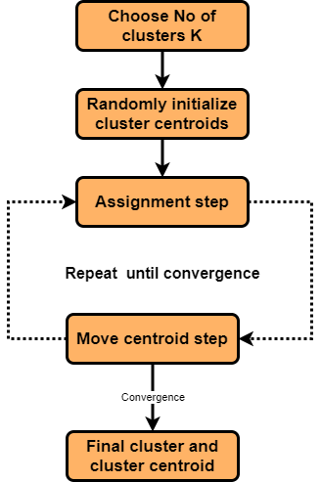
How Does K-Means Work?
Initialization:
Select K random centroids.
2. Assignment Step:
Assign each data point to the nearest
centroid.
3. Update Step:
Recalculate centroids as the mean of all
points in a cluster.
4. Repeat:
Iterate until centroids no longer change
significantly.
Goal: Group similar data while minimizing the distance between each point and its cluster center.

Slide 4
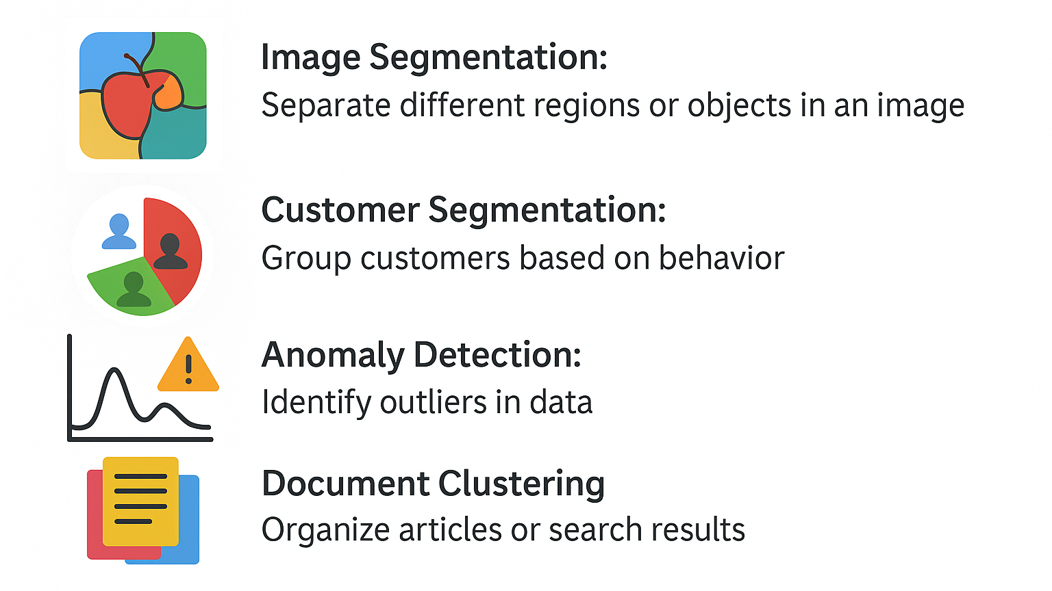
Applications of K-Means

Slide 5
Advantages/Limitations
Advantages | Limitations
Simple to implement and computationally efficient | Requires predefining the number of clusters (k)
Works well with spherical-shaped, well-separated clusters | Sensitive to the initial placement of centroids
Efficient for large datasets (O(n⋅k⋅t)) | Assumes clusters are spherical and of equal size
Performs well with linearly separable data | Struggles with overlapping or non-linear clusters
Scales easily for parallel and distributed processing | Sensitive to outliers that can skew centroids

Slide 6
Background and Related Work
Paper | Approach | Key Contribution
A Comparative study of parallel CPU and GPU implementations of the K-Means Algorithm | Compared CPU OpenMP, GPU OpenCL, and sequential K-Means | GPU effective on large data; OpenMP better for smaller datasets
Accelerating K-Means clustering with parallel implementations and GPU computing | Implemented OpenMP, MPI, and CUDA-C versions of K-Means | CUDA outperformed others on large images; OpenMP better on smaller ones
Improved Parallel k-means Clustering Algorithm | Enhanced OpenMP with outlier removal, smarter centroid initialization, and memory-aware partitioning | 20% fewer iterations; improved consistency and speed; applied to U.S. payroll dataset
Parallel processing of enhanced K-means using OpenMP | Proposed OpenMP-based enhanced K-Means with sorted data preprocessing and outlier filtering | Improved accuracy (~80%) and reduced execution time on real-world datasets like diabetes and retail

Slide 7
Objectives
Measure execution time for three approaches standard sequential, parallel GPU computation and parallel GPU with momentum and repulsion .
Evaluate scalability with varying cluster sizes.
Calculate Speed-Up of parallel execution with respect to sequential

Slide 8
Experimental Setup
Device specification:
GPU Model: NVIDIA A100-SXM4-40GB
Total GPUs: 4
Memory per GPU: 40,536 MiB (≈ 40 GB)
Architecture: Ampere
CUDA Version: 11.4
Driver Version: 470.161.03

Slide 9
Experimental Setup
In this experiment we have used three methods.
1. Sequential Standard K-Means Algorithm • This is the baseline method where clustering is performed sequentially on the CPU. • The algorithm runs on multiple datasets. • The number of clusters (K) varies from 2 to 1024, increasing in powers of 2. • For each dataset and cluster configuration, execution time is recorded. • Purpose: To serve as a reference for evaluating parallel implementations. 2. Parallel K-Means Using GPU (CUDA) • Implements K-Means using GPU parallelism via CUDA. • Each GPU thread handles one data point, enabling massive parallelism. • The GPU performs: - Distance calculation - Cluster assignment - Partial accumulation for centroid updates • Like the sequential method, it runs on datasets with K = 2 to 1024 (powers of 2). • Execution time is measured to compare speedup over the sequential version.

Slide 10
Proposed Methodology
Parallel GPU computation with momentum and repulsion
Parallel K-Means with GPU, Momentum, and Repulsion • Extends the GPU-based K-Means with two enhancements: - Momentum: Smooths the movement of centroids over iterations to avoid oscillations and help faster convergence. - Centroid Repulsion: Adds a repulsive force between centroids to prevent collapse and improve cluster separation. • Maintains full GPU acceleration for computation. • Incorporates stability metrics and convergence checks. • Tested with varying K (2 to 1024) on different datasets. • Execution time is measured to compare speedup over other two methods.

Slide 11
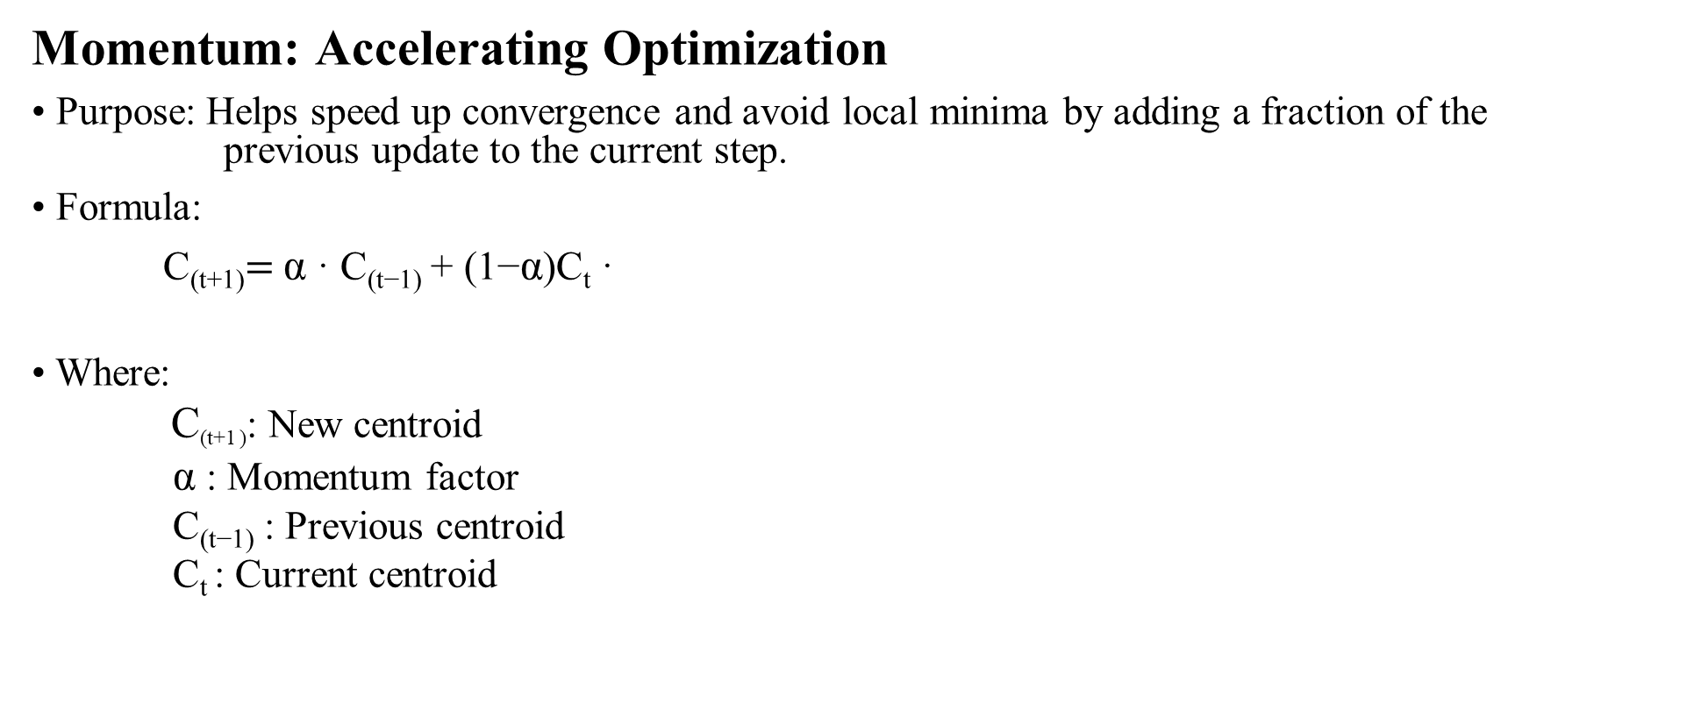
Momentum
Momentum: Accelerating Optimization
• Purpose: Helps speed up convergence and avoid local minima by adding a fraction of the previous update to the current step.
• Formula:
C_{(t+1)}$=$ α · C_{(t−1)} + (1−α)C_{t} ·
• Where: C_{(t+1 )}: New centroid α : Momentum factor C_{(t−1)} : Previous centroid C_{t} : Current centroid

Slide 12
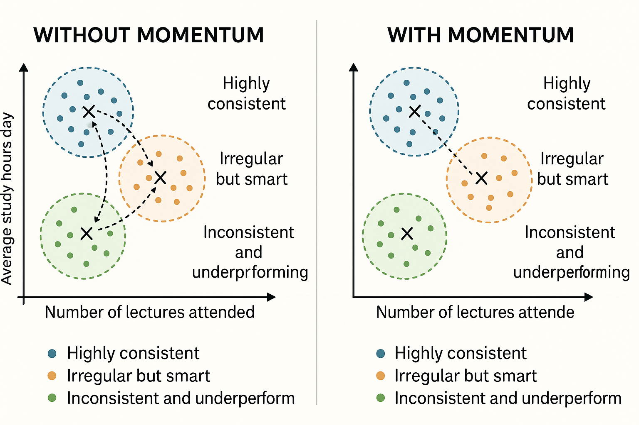
Momentum

Slide 13
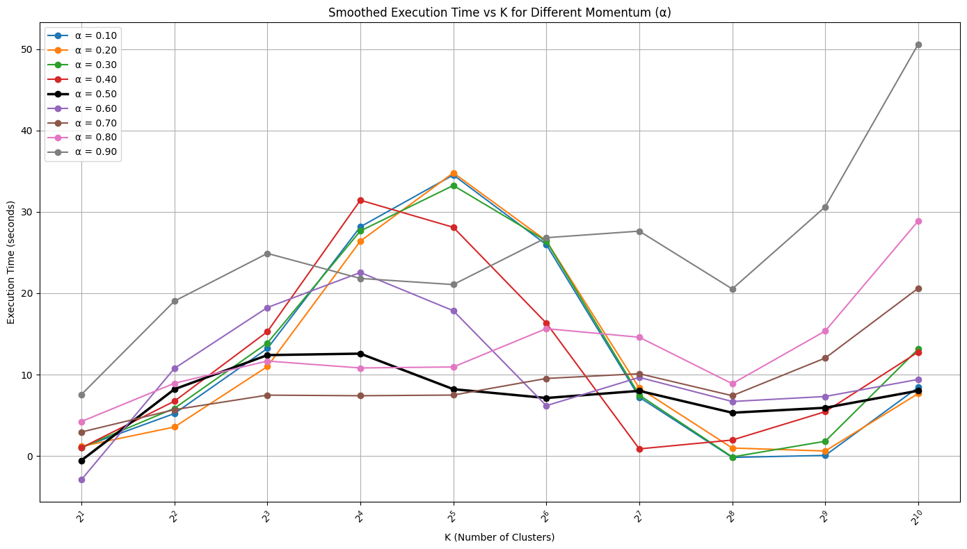
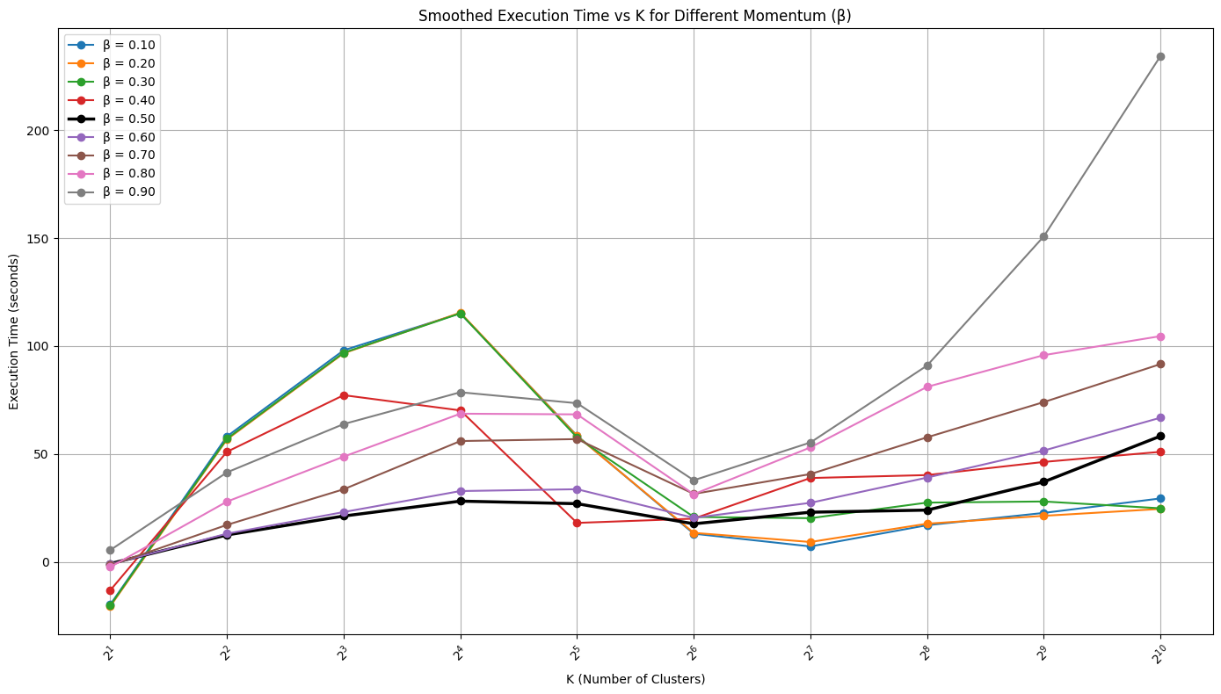
Momentum
Experiment performed on 10 and 20 dimension 1 million data points
10D
20D

Slide 14
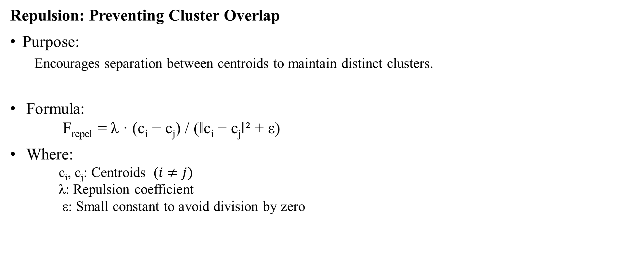
Repulsion
Repulsion: Preventing Cluster Overlap
Purpose:
Encourages separation between centroids to maintain distinct clusters.
Formula: F_{repel} = λ · (c_{i} − c_{j}) / (‖c_{i} − c_{j}‖² + ε)
Where: c_{i}, c_{j}: Centroids ($i≠j)$ λ: Repulsion coefficient ε: Small constant to avoid division by zero

Slide 15
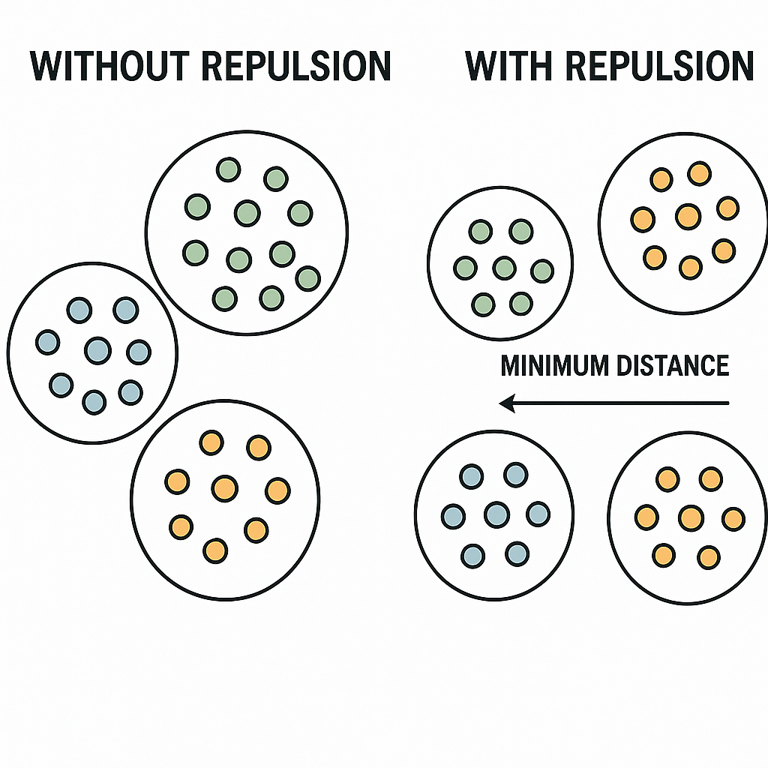
Repulsion

Slide 16
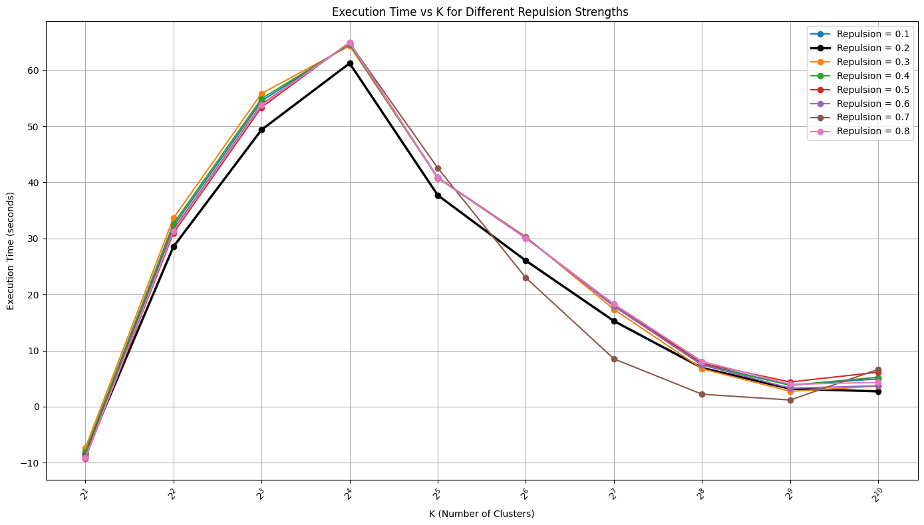
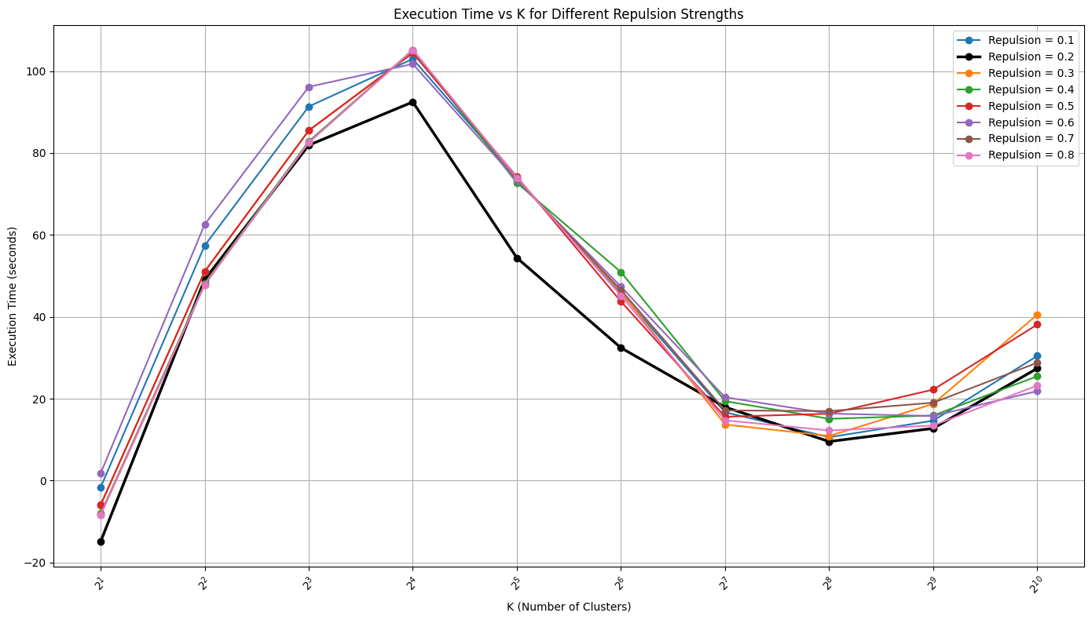
Repulsion
Experiment performed on 10 and 20 dimension 1 million data points
10D
20D

Slide 17
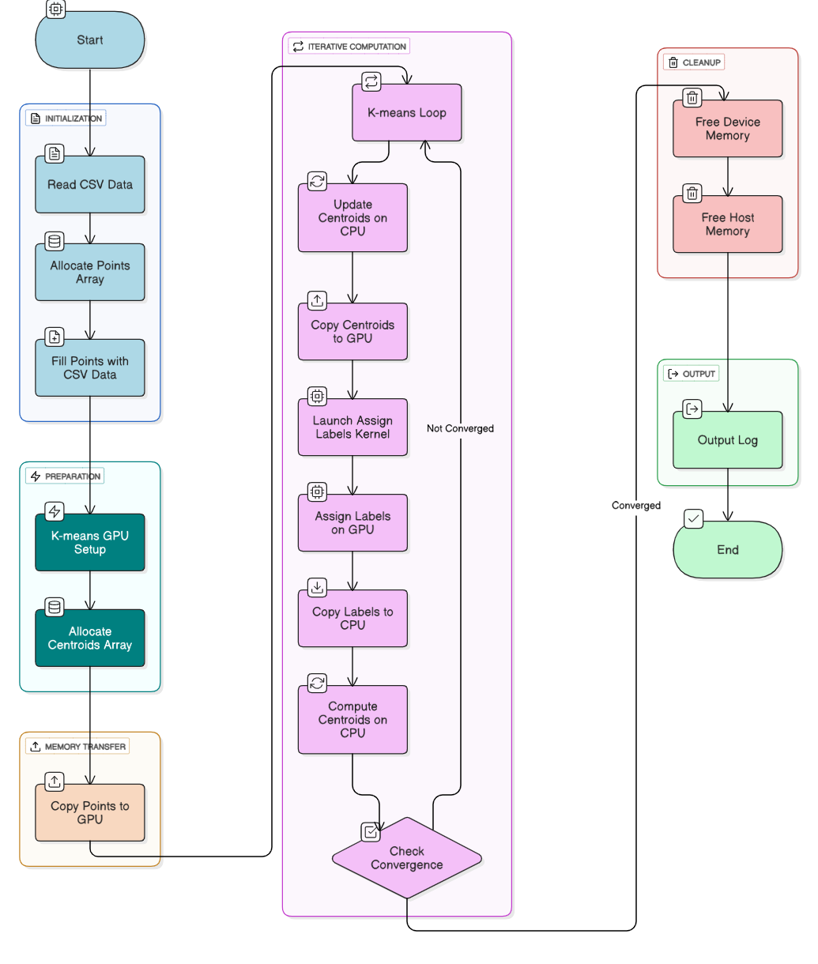
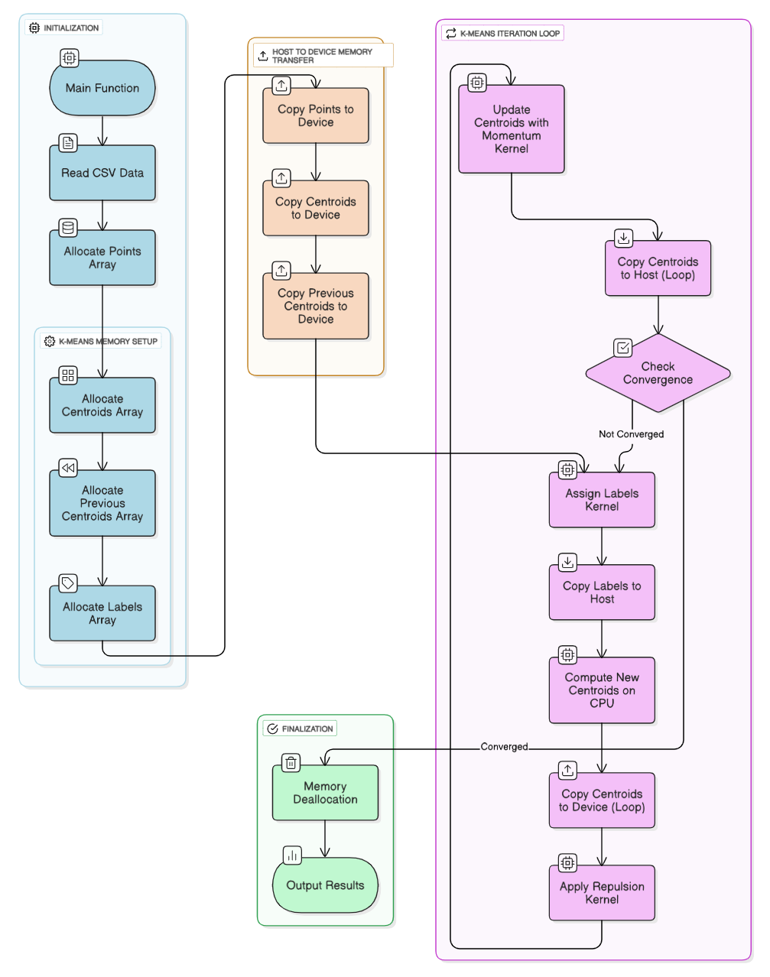
Flow Chart
GPU method
GPU with Momentum + Repulsion

Slide 18
Results
Experiment performed on 4 dimension 1 million data points
Cluster (K) | Standard | GPU | GPU Momentum + Repulsion
2 | 0.296569 | 0.296507 | 0.519277
4 | 0.461334 | 0.452083 | 1.403825
8 | 1.619167 | 1.158718 | 0.418216
16 | 2.961701 | 2.46047 | 1.517763
32 | 3.206758 | 5.819879 | 0.943908
64 | 4.706177 | 4.591391 | 2.035499
128 | 9.367932 | 8.79898 | 1.369249
256 | 20.323554 | 11.475081 | 2.987366
512 | 44.966617 | 12.211571 | 1.891046
1024 | 76.291587 | 20.429979 | 4.833307

Slide 19
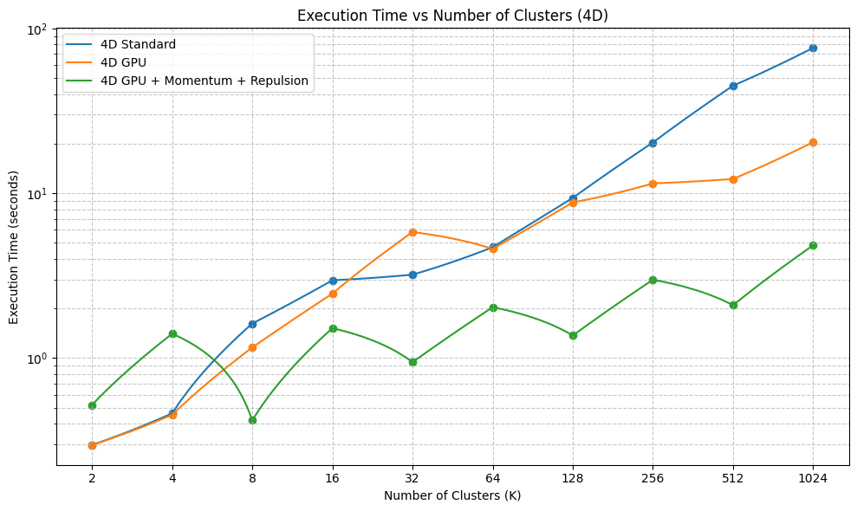
Results
Experiment performed on 4 dimension 1 million data points

Slide 20
Results
Experiment performed on 10-dimension 1and 2 million data points
Cluster (K) | Standarde | GPU | GPU Momentum + Repulsion
2 | 0.674249 | 2.470305 | 1.12799
4 | 1.812546 | 9.896647 | 5.012217
8 | 5.429024 | 9.232534 | 39.595617
16 | 8.017289 | 14.451347 | 57.858884
32 | 26.066889 | 21.385833 | 6.902425
64 | 43.036178 | 18.580721 | 5.967438
128 | 80.235135 | 45.664896 | 12.706627
256 | 165.466417 | 27.081763 | 3.901871
512 | 205.439472 | 14.233428 | 3.566083
1024 | 583.841201 | 27.171629 | 13.917907
Cluster (K) | Standard | GPU | GPU Momentum + Repulsion
2 | 1.170701 |  | 1.66084
4 | 2.662576 | 51.158314 | 10.285358
8 | 10.101155 | 22.410627 | 11.613233
16 | 23.32404 | 47.905344 | 7.026268
32 | 55.338892 | 29.04075 | 6.604053
64 | 87.352596 | 94.896868 | 17.935235
128 | 163.945134 | 195.688807 | 15.134655
256 | 299.743185 | 35.831732 | 6.29401
512 | 580.113346 | 47.213676 | 10.659376
1024 | 1139.39819 | 98.749503 | 36.242918

Slide 21
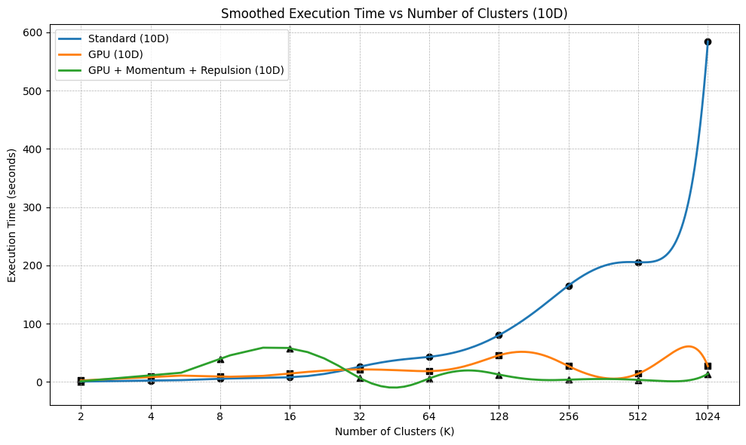
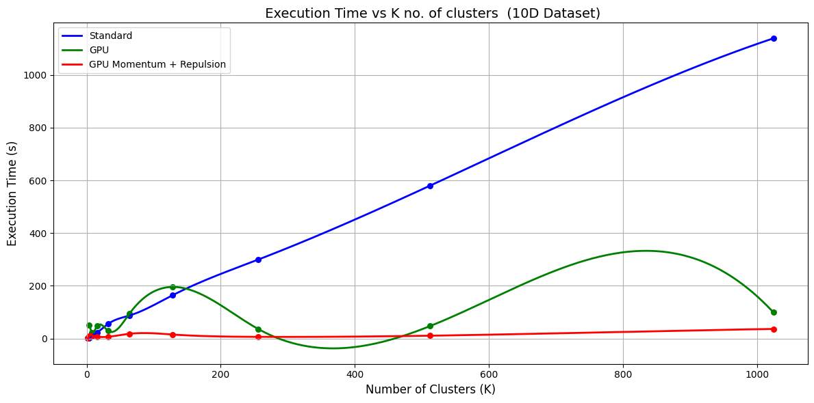
Results
Experiment performed on 10 dimension 1 million data points

Slide 22
Results
Experiment performed on 20-dimension 1and 2 million data points
Cluster (K) | Standard | GPU | GPU Momentum + Repulsion
2 | 3.471949 | 3.195124 | 2.564578
4 | 14.115874 | 12.300821 | 9.114394
8 | 17.286839 | 15.950327 | 12.117401
16 | 20.97192 | 18.541699 | 40.228734
32 | 38.257986 | 32.612754 | 32.423959
64 | 158.722948 | 112.309053 | 14.757686
128 | 144.298483 | 121.977751 | 49.048821
256 | 214.971446 | 210.506621 | 21.01389
512 | 398.206249 | 136.457146 | 42.938734
1024 | 776.561282 | 95.505333 | 65.144046
Cluster (K) | Standard | GPU | GPU Momentum + Repulsion
2 | 3.264925 | 9.314971 | 3.580846
4 | 8.924567 | 12.153473 | 17.765437
8 | 12.871876 | 15.984212 | 13.870501
16 | 42.315495 | 34.246791 | 37.989413
32 | 71.734961 | 53.69871 | 43.445636
64 | 111.696608 | 74.224198 | 50.356395
128 | 208.129031 | 88.129163 | 72.614175
256 | 375.48741 | 107.292448 | 67.567423
512 | 722.978365 | 131.488442 | 87.211669
1024 | 1415.595398 | 367.939566 | 270.039592

Slide 23
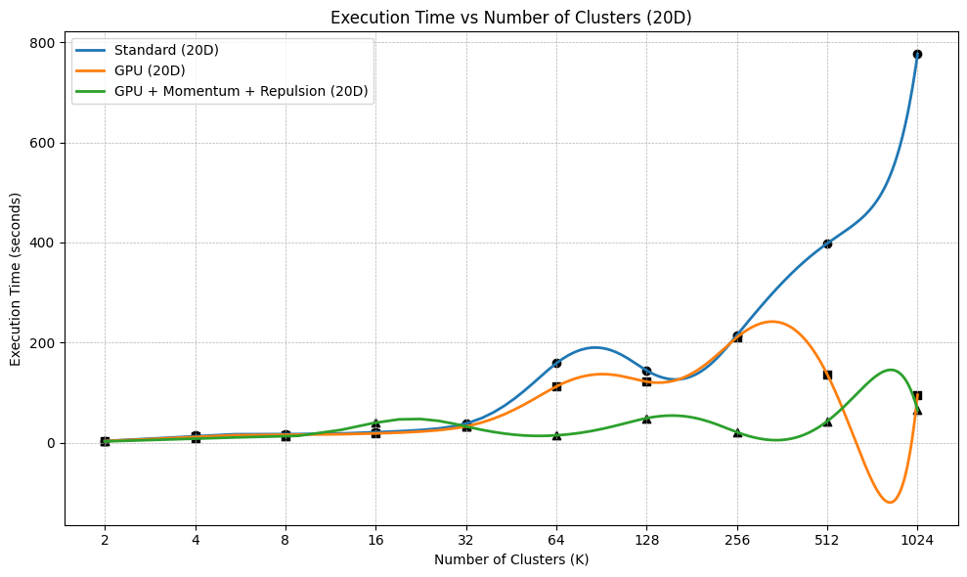
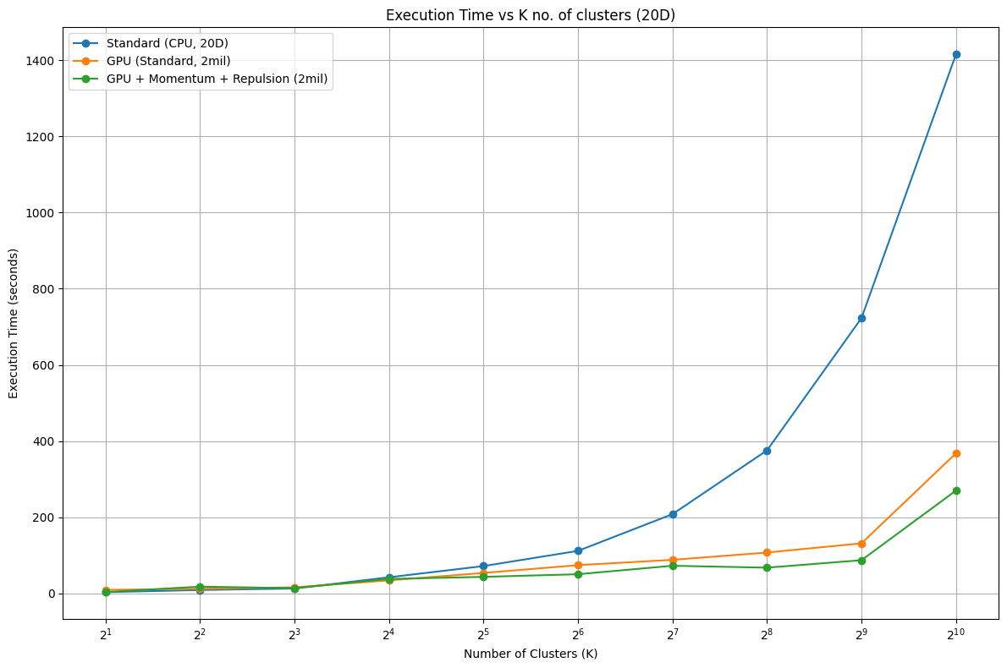
Results
Experiment performed on 20 dimension 1 million data points

Slide 24
Observations
Increase in Speed-Up
Cluster K | Std vs GPU | Std vs GPU(M+R) | GPU vs GPU( M+R)
2 | 0.7865 | 0.8408 | 1.336
4 | 0.7838 | 0.7463 | 1.2147
8 | 1.0232 | 1.8119 | 1.4401
16 | 1.9631 | 1.87 | 1.777
32 | 1.9809 | 2.7841 | 3.4235
64 | 1.5848 | 6.761 | 4.3271
128 | 1.3349 | 5.3651 | 4.1691
256 | 2.9671 | 19.8115 | 6.9326
512 | 7.0116 | 30.2239 | 4.5423
1024 | 11.118 | 23.222 | 2.5487
Average | 2.85539 | 9.24366 | 3.07111
Relative Performance of K-Means Variants (Std, GPU, M+R)

Slide 25
Conclusion
• GPU alone provides ~2.66x speedup over Standard implementation.
• GPU with Momentum + Repulsion provides ~9.06x speedup over Standard.
• Adding Momentum + Repulsion improves GPU performance by ~3.27x.
• Highest gains observed at K=256 and K=512, confirming scalability.
• Use plain GPU for small K (≤6) and GPU with Momentum + Repulsion for largeK(≥8).

Slide 26
THANK YOU

